Slide 1
Integrated risk management
Final project
2021.12.14
Sungwoo Hur

Slide 2
Data description
The model framework
Analysis
Conclusion

Slide 3
Introduction
Research question
How much reserve a health insurance company should have?
Can we predict health expenditures if medical information is given?
(If we can, we can calculate expected reserve.)
Therefore, the research objective is to explain/ predict health expenditure.
MEPS data were used for the research, and only outpatient expenditure was considered as a response variable.

Slide 4
1. Data description
MEPS data
MEPS stands for “Medical Expenditure Panel Survey”.
It began in 1996, and it is a set of large-scale surveys of families and individuals, their medical providers (doctors, hospitals, pharmacies, etc.) and employers across the United States.
MEPS collects data on the specific health services that Americans use.

Slide 5
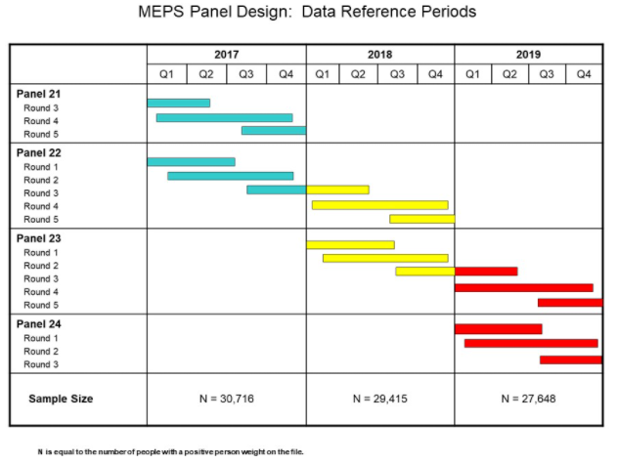
1. Data description
MEPS data collection procedures
The sampling frame is drawn from respondents to the National Health Interview Survey (NHIS), which is conducted by the National Center for Health Statistics.
The MEPS-HC collects data from a nationally representative sample of households through an overlapping panel design.
The chart above illustrates the timing and relationship between panels, rounds, and calendar years.
(Image source: MEPS homepage (https://www.meps.ahrq.gov/survey_comp/hc_data_collection.jsp))

Slide 6
1. Data description
MEPS data collection procedures
A new panel of sample households is selected each year, data for each panel are collected for two calendar years.
The two years of data for each panel are collected in five rounds of interviews that take place over a two-and-a-half-year period.

Slide 7
1. Data description
MEPS data collection procedures
This procedure (Panel-Round collection procedure) provides continuous and current estimates of health care expenditures at both the person and household level for two panels for each calendar year.
However, in this work, 2,000 individual data were sampled from 18,735 individual data collected since 2003 (panel 6 and 7).
Therefore, the sample data itself is not time series. (One observation per individual)

Slide 8
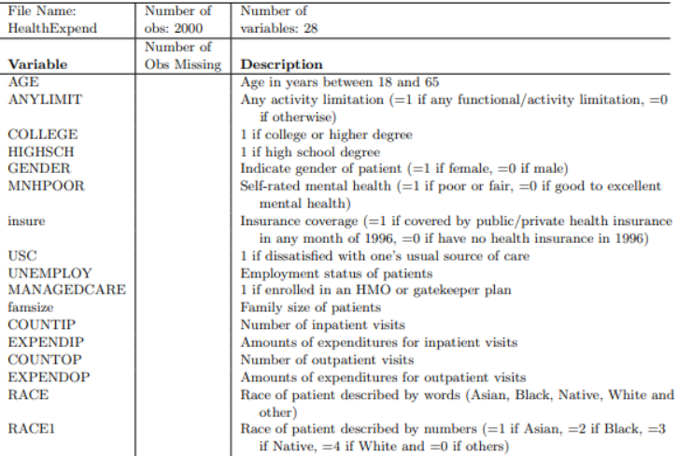

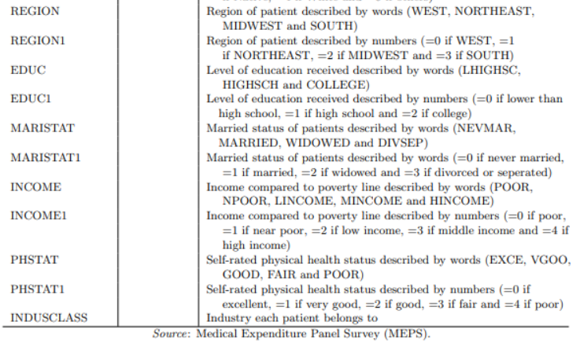
1. Data description
Data descriptions
Dependent variables

Slide 9
1. Data description
Effects of category features
Effects were simply estimated by taking average of each category group. Remarkable features are as follows.
He/ she is more likely to spend health expenditure if he or she:
has any activity limitation.
has insurance coverage.
is unsatisfactory with his/ her current health service
is a female
If he/ she thinks he/ she is in a “POOR” condition. (he/ she is not likely to spend health expenditure when he/ she is in an excellent condition.)

Slide 10
1. Data description
Effects of category features
Effects were simply estimated by taking average of each category group. Remarkable features are:
He/ she is more likely to spend health expenditure if he or she:
is a native American. (he/ she is likely to spend little if he/ she is an Asian.)
Notice that contrary to the Social conventional wisdom, income does not significantly affect the expenditure pattern.

Slide 11
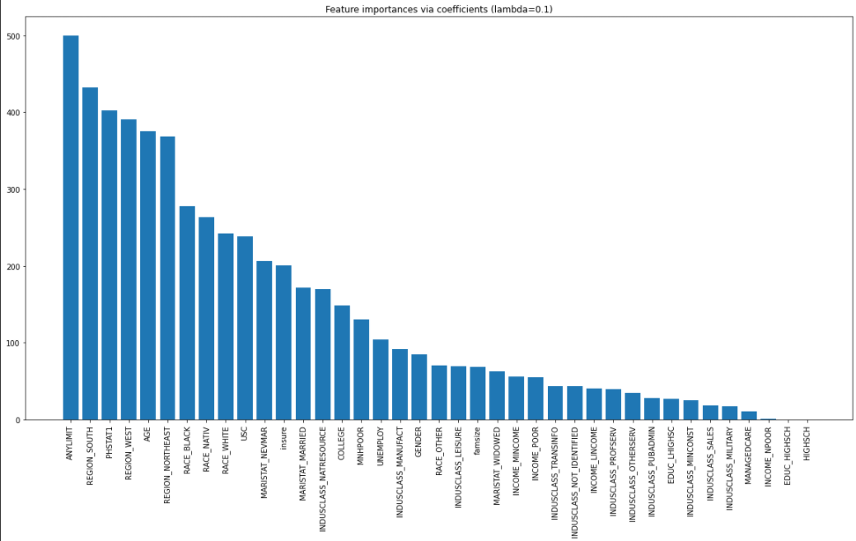
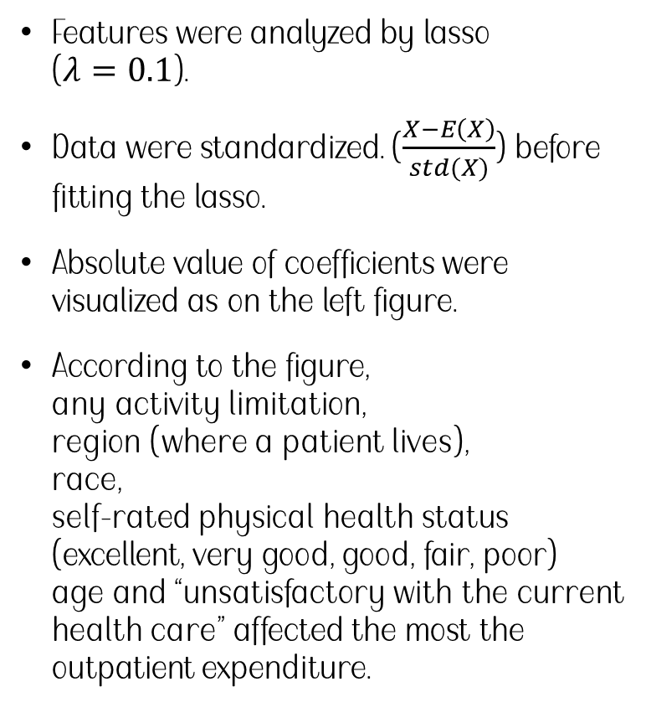
1. Data description
MEPS lasso results - intuition
Features were analyzed by lasso ($λ=0.1$).
Data were standardized. ($\frac{X−E\left(X\right)}{std(X)}$) before fitting the lasso.
Absolute value of coefficients were visualized as on the left figure.
According to the figure, any activity limitation, region (where a patient lives), race, self-rated physical health status (excellent, very good, good, fair, poor) age and “unsatisfactory with the current health care” affected the most the outpatient expenditure.

Slide 12
1. Data description
MEPS lasso results - intuition
However, we have some issues for this simple model.
These will be discussed in the next slides.

Slide 13
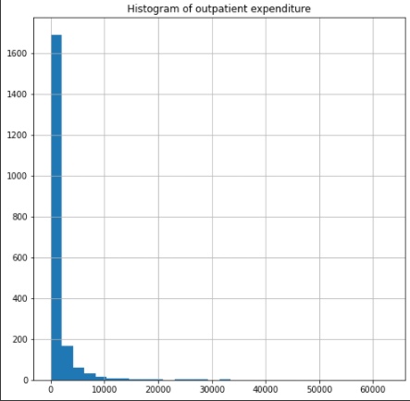
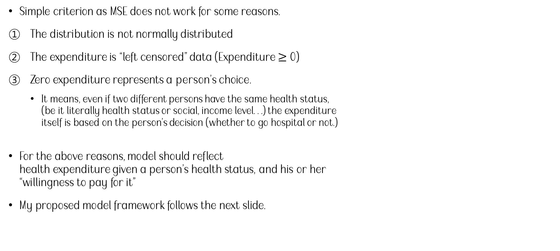
2. The model framework
Some modeling issues
Simple criterion as MSE does not work for some reasons.
The distribution is not normally distributed
The expenditure is “left censored” data (Expenditure $≥$ 0)
Zero expenditure represents a person’s choice.
It means, even if two different persons have the same health status, (be it literally health status or social, income level…) the expenditure itself is based on the person’s decision (whether to go hospital or not.)
For the above reasons, model should reflect health expenditure given a person’s health status, and his or her “willingness to pay for it”
My proposed model framework follows the next slide.

Slide 14
2. The model framework
Proposed model framework
The proposed model is based on ‘two parts model’ which separates severity and binary decision.
The framework will be described in 3 aspects.
Joint distribution/ objective function design/ model structure.

Slide 15
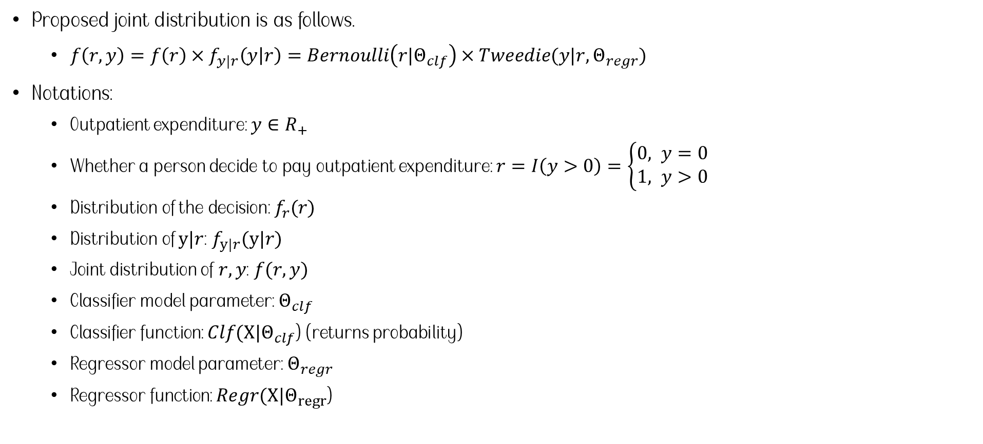
2. The model framework
Proposed joint distribution
Proposed joint distribution is as follows.
$f\left(r,y\right)=f\left(r\right)×f_{y|r}\left(y | r\right)=Bernoulli\left(r|Θ_{clf}\right)×Tweedie(y|r,Θ_{regr})$
Notations:
Outpatient expenditure: $y∈R_{+}$
Whether a person decide to pay outpatient expenditure: $r=I\left(y>0\right)=\left\{\begin{aligned}0, y=0 \\ &1, y>0\end{aligned}\right.$
Distribution of the decision: $f_{r}(r)$
Distribution of $y|r$: $f_{y|r}(y|r)$
Joint distribution of $r, y$: $f(r, y)$
Classifier model parameter: $Θ_{clf}$
Classifier function: ${Clf(X|Θ}_{clf}$) (returns probability)
Regressor model parameter: $Θ_{regr}$
Regressor function: ${Regr(X|Θ}_{regr}$)

Slide 16

2. The model framework
Proposed joint distribution
Proposed joint distribution is as follows.
$f\left(r,y\right)=f\left(r\right)×f_{y|r}\left(y | r\right)=Bernoulli\left(r|Θ_{clf}\right)×Tweedie(y|r,Θ_{regr})$
Bernoulli distribution was chosen because a person’s decision is whether to pay for medical service or not.
Tweedie distribution was chosen because the expenditure distribution is rather Poisson, compound Poisson, Gamma distribution than normal distribution.

Slide 17






2. The model framework
Objective function design
Based on the proposed joint distribution, likelihood is as follows.
$\prod_{i=1}^{N}{p_{i}^{r_{i}}{\left(1−p_{i}\right)}^{1−r_{i}}×Tweedie(y_{i},{\hat{y}}_{i}|X_{i},r_{i}>0,Θ_{regr}, variance power )}$
Where $,p_{i}=Pr(r_{i}=1|X_{i},Θ_{clf})$
The likelihood itself is hard to optimize so relaxed the ‘multi-task’ problem into the ‘separate’ modeling problem.
It is to train the classifier and the regressor separately as follows.
Training dataset
Observation with $r_{i}=1$
Observation with $r_{i}=0$
Learn Regressor ($Θ_{regr}$)
Proposed model {$Θ_{regr}$, $Θ_{clf}$}
Learn Classifier ($Θ_{clf}$)

Slide 18
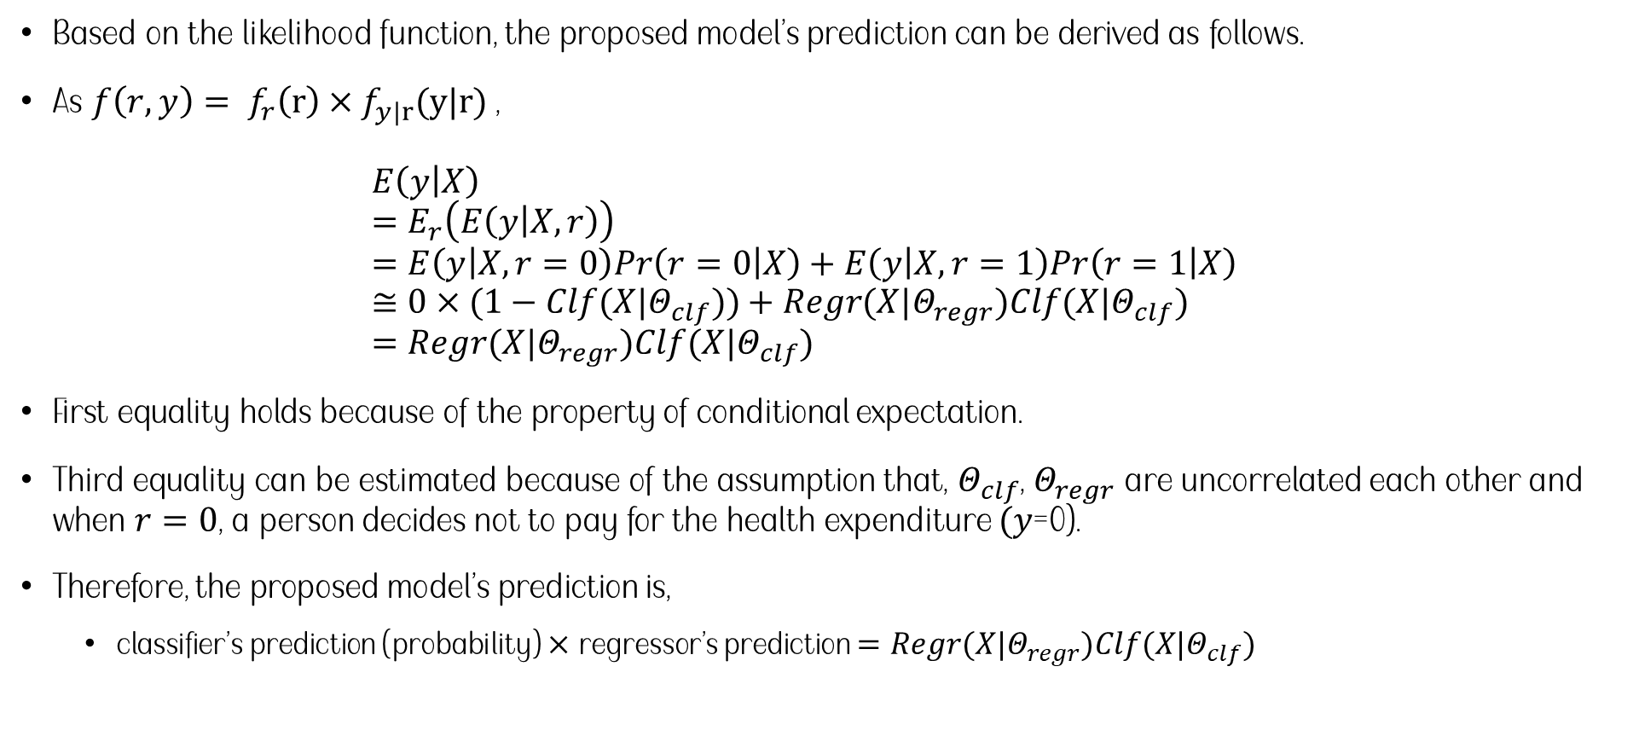
2. The model framework
Model’s prediction
Based on the likelihood function, the proposed model’s prediction can be derived as follows.
As $f\left(r,y\right)= f_{r}\left(r\right)×f_{y|r}(y|r)$, $E\left(y | X\right)$ $=E_{r}\left(E\left(y | X,r\right)\right)$ $=E\left(y | X,r=0\right)Pr\left(r=0 | X\right)+E\left(y | X,r=1\right)Pr\left(r=1 | X\right)$ $≅{0×(1−Clf(X|Θ}_{clf}))+Regr(X|Θ_{regr})Clf(X|Θ_{clf})$ $=Regr(X|Θ_{regr})Clf(X|Θ_{clf})$
First equality holds because of the property of conditional expectation.
Third equality can be estimated because of the assumption that, $Θ_{clf}$, $Θ_{regr}$ are uncorrelated each other and when $r=0$, a person decides not to pay for the health expenditure $(y\text{=0}$).
Therefore, the proposed model’s prediction is,
classifier’s prediction (probability) $×$ regressor’s prediction $=Regr(X|Θ_{regr})Clf(X|Θ_{clf})$

Slide 19





2. The model framework
Model structure
The total model structure is as follows.
Training dataset
Observation with $r_{i}=1$
Observation with $r_{i}=0$
Learn Regressor ($Θ_{regr}$)
Proposed model {$Θ_{regr}$, $Θ_{clf}$}
Learn Classifier ($Θ_{clf}$)
Prediction: classifier’s prediction (probability) $×$ regressor’s prediction
$=Regr(X|Θ_{regr})Clf(X|Θ_{clf})$

Slide 20
2. The model framework
Model evaluation
Some combinations of “Regressors” and “Classifiers” were considered.
Hyper parameters are as follows. (The same hyper parameters were chosen for both regression and classification)
Regressor | Classifier | Proposed model (Regressor X Classifier)
CatBoost | CatBoost | CatBoost X CatBoost
Random forest | Random forest | Random forest X Random forest
XGBoost | XGBoost | XGBoost X XGBoost
Logistic regression | Linear regression | Logistic regression X Linear regression
Algorithm | Hyper parameter settings | Tweedie distribution (variance power)
CatBoost | Default setting | 1.8
Random forest | Default setting | 1.8
XGBoost | Default setting | 1.8
Logistic regression | - | 1.8

Slide 21
2. The model framework
Model evaluation
Mean Absolute Error was computed as a measure of goodness of fit.
10fold-cross validation was conducted.
It has been rounded to two decimal places.
Proposed model (Regressor X Classifier) | MAE for the training dataset (Standard Deviation) | MAE for the test dataset (Standard Deviation)
CatBoost X CatBoost | 1086.48 (25.30) | 1155.54 (245.53)
Random forest X Random forest | 575.99 (20.96) | 1382.28 (259.95)
XGBoost X XGBoost | 575.29 (20.67) | 1380.93 (256.71)
Logistic regression X Linear regression | 1213.59 (35.28) | 1224.03 (223.49)
Regressor | MAE for the training dataset (Standard Deviation) | MAE for the test dataset (Standard Deviation)
CatBoost | 1329.82 (34.36) | 1396.39 (233.75)
Random forest | 1000.40 (32.78) | 1894.67 (241.44)
XGBoost | 999.07 (36.01) | 1897.12 (244.90)
Linear regression | 1629.90 (47.48) | 1636.51 (196.69)

Slide 22
2. The model framework
Model evaluation
Considering its MAE as well as generalization performance, the proposed model (Regressor X Classifier) performed better than simple regressor.
Proposed model (Regressor X Classifier) | MAE for the training dataset (Standard Deviation) | MAE for the test dataset (Standard Deviation)
CatBoost X CatBoost | 1086.48 (25.30) | 1155.54 (245.53)
Random forest X Random forest | 575.99 (20.96) | 1382.28 (259.95)
XGBoost X XGBoost | 575.29 (20.67) | 1380.93 (256.71)
Logistic regression X Linear regression | 1213.59 (35.28) | 1224.03 (223.49)
Regressor | MAE for the training dataset (Standard Deviation) | MAE for the test dataset (Standard Deviation)
CatBoost | 1329.82 (34.36) | 1396.39 (233.75)
Random forest | 1000.40 (32.78) | 1894.67 (241.44)
XGBoost | 999.07 (36.01) | 1897.12 (244.90)
Linear regression | 1629.90 (47.48) | 1636.51 (196.69)

Slide 23
2. The model framework
Model evaluation
In addition, models’ prediction performance of zero and nonzero expenditures were experimented separately.
Models | CatBoost X CatBoost |  |  | Random forest X Random forest |  |  | XGBoost X XGBoost |  |  | Logistic regression X Linear regression
 | Classifier (accuracy) | Regressor | Classifier X Regressor | Classifier (accuracy) | Regressor | Classifier X Regressor | Classifier (accuracy) | Regressor | Classifier X Regressor | Classifier (accuracy) | Regressor | Classifier X Regressor
MAE for the zero expenditures (training/ test) | 0.81/ 0.69 | 905.10/ 934.55 | 340.01/ 417.99 | 1.0/ 0.69 | 1530.08/ 1498.27 | 229.38/ 426.75 | 0.87/ 0.66 | 897.18/ 885.10 | 276.35/ 392.17 | 0.74/ 0.72 | 1323.68/ 1313.07 | 504.45/ 594.32
MAE for the nonzero expenditures (training/ test) | 0.78/ 0.72 | 1492.68/ 2054.45 | 1579.52/ 1328.78 | 1.0/ 0.70 | 777.39/ 2258.01 | 746.01/ 1448.21 | 0.85/ 0.66 | 916.15/ 1810.52 | 980.22/ 1456.87 | 0.74/ 0.71 | 1795.23/ 1749.22 | 1561.46/ 1562.33
Models Overfitted the training data
Notice its improvement in prediction performance in zero expenditure
Best performance (considering generalization).

Slide 24
2. The model framework
Model evaluation
Notice that,
CatBoost prevented “target leakage problem” inherent in the boosting algorithm. Therefore, unlike XGBoost, CatBoost didn’t overfit the data.
CatBoost prevents Target leakage by adapting online learning setting to that of the offline learning.
(“Ordered boosting” and “ordered target statistic” are used to avoid the target leakage.)
Every “two parts model” performed better than simple regression models.
MEPS data was analyzed using the CatBoost X CatBoost taking the expectation of the performance into account.
However, it is controversy that CatBoost performed better than the traditional regression model, because the difference of the mean value between them are within one standard error.

Slide 25
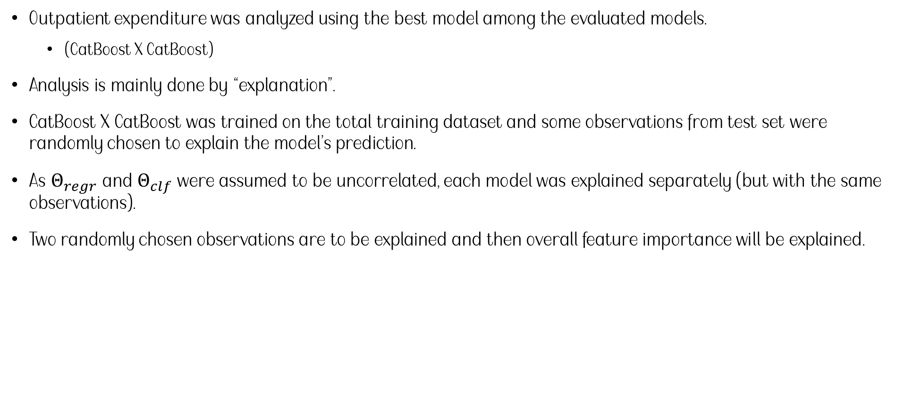
3. Analysis
Analysis
Outpatient expenditure was analyzed using the best model among the evaluated models.
(CatBoost X CatBoost)
Analysis is mainly done by “explanation”.
CatBoost X CatBoost was trained on the total training dataset and some observations from test set were randomly chosen to explain the model’s prediction.
As $Θ_{regr}$ and $Θ_{clf}$ were assumed to be uncorrelated, each model was explained separately (but with the same observations).
Two randomly chosen observations are to be explained and then overall feature importance will be explained.

Slide 26
3. Analysis
Prototyping
First sample:
No activity limitation,
Academic background: high school
Female
No insurance
Dissatisfied with her usual source of care
Unemployed (Currently no job)
Enrolled in HMO (Health Maintenance Organization) – Health insurance
Family size = 1 (Living alone)
Self-rated physical health = very good (0: Excellent, 1: very good, 2: good, 3: fair, 4: poor)
Income level: Low income (0: Poor, 1: Near poor, 2: Low income, 3: middle income, 4: high income)

Slide 27
3. Analysis
Prototyping
First sample:
She has
True expenditure: $894.33
Model’s prediction: 0.753 (probability of decision to pay) X 1469.65 (expenditure) = 1107.81
Our question is, “Why does the model think her willingness to pay is about 75 % and the expenditure is about $ 1469?”
We use Shapley value to answer the question.

Slide 28
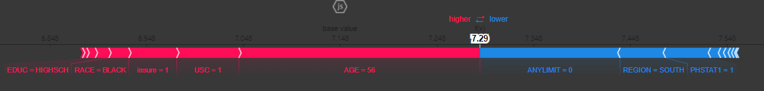
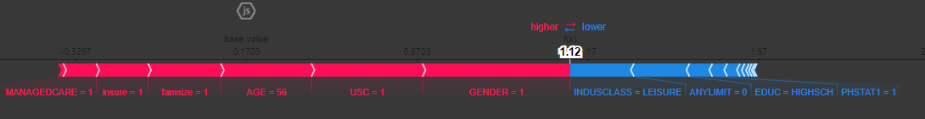
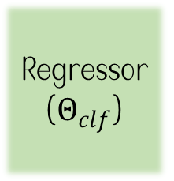

3. Analysis
Prototyping
She has True expenditure: $894.33 and Model’s prediction: 0.753 (probability of decision to pay) X 1469.65 (expenditure) = 1107.81
The below explanation shows features each contributing to push the model output from the base value
Base value is the average model output over the training dataset.
Features pushing the prediction higher are shown in red, those pushing the prediction lower are in blue.
Regressor ($Θ_{clf}$)
Classifier ($Θ_{clf}$)

Slide 29


3. Analysis
Prototyping
Regressor ($Θ_{clf}$)
Classifier ($Θ_{clf}$)
Age of 56, “unsatisfactory with her usual source of care” and insurance increased her health expenditure while, no activity limitation lowered it.
Enrollment in health insurance, age, unsatisfactory with her usual source of care, and her gender increased the probability to willing to pay for the expenditure while no activity limitation and her working place (leisure) lowered the probability.

Slide 30
3. Analysis
Prototyping
Second sample:
No activity limitation,
Academic background: High school
Male
No insurance
Unsatisfied with her usual source of care
Employed (Currently has a job)
Not enrolled in HMO (Health Maintenance Organization) – Health insurance
Family size = 2 (he’s married.)
Self-rated physical health = good (0: Excellent, 1: very good, 2: good, 3: fair, 4: poor)
Income level: High income (0: Poor, 1: Near poor, 2: Low income, 3: middle income, 4: high income)

Slide 31
3. Analysis
Prototyping
First sample:
He has
True expenditure: $327.54
Model’s prediction: 0.34 (probability of decision to pay) X 693.31 (expenditure) = $236.73
Our question is, “Why does the model think her willingness to pay is about 7 % and the expenditure is about $ 693.31?”
We use Shapley value to answer the question.

Slide 32
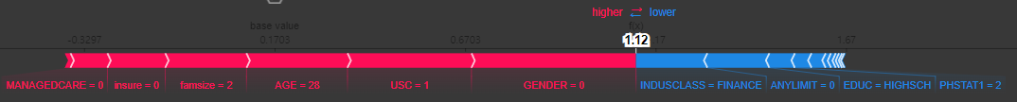
3. Analysis
Prototyping
She has True expenditure: $327.54 and Model’s prediction: 0.34 (probability of decision to pay) X 693.31 (expenditure) = $236.73
The below explanation shows features each contributing to push the model output from the base value.
Base value is the average model output over the training dataset.
Features pushing the prediction higher are shown in red, those pushing the prediction lower are in blue.
Regressor ($Θ_{clf}$)
Classifier ($Θ_{clf}$)

Slide 33


3. Analysis
Prototyping
Regressor ($Θ_{clf}$)
Classifier ($Θ_{clf}$)
Age of 28, “unsatisfactory with her usual source of care but no insurance” increased her health expenditure while, no activity limitation lowered it.
No health insurance, age, unsatisfactory with her usual source of care, and her gender increased the probability to willing to pay for the expenditure while no activity limitation and her working place (Finance) lowered the probability.

Slide 34
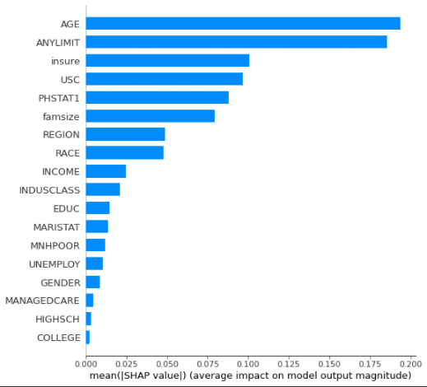
3. Analysis
Overall feature importance
Feature importance of the regressor.
Age, any activity limitation, insurance coverage and unsatisfactory with usual medical service were main features of the regression model.

Slide 35
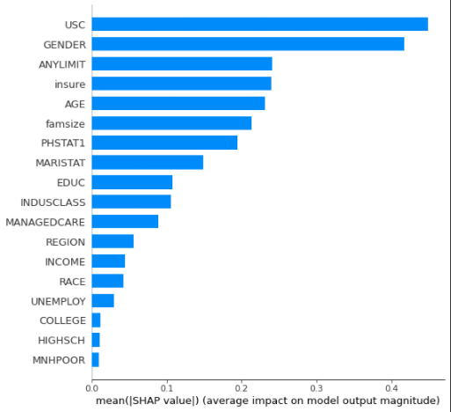
3. Analysis
Overall feature importance
Feature importance of the classifier.
Unsatisfactory with usual medical service, gender, any activity limitation and insurance coverage were main features of the classifier.
Further notice that Region which was an important factor according to the lasso, is not that significant in this framework.

Slide 36
4. Conclusion
Conclusion
MEPS data analysis
The binary decision and the amount” can be predicted by his/ her current financial (insurance coverage), health status (self rated physical status).
Intuitive explanation about individual prediction was made by SHAP
Research contribution
Careful manipulation of likelihood and “proxy” optimization advanced the model’ s performance.
Proxy optimization refers to the separate optimization of the regression and the classification.
Limitations:
Couldn’t solve the relatively large variance of MAE in the test data set.
Proxy method was used to find MLE (Maximal Likelihood Estimate)

